Slide 1






science-based target setting
METHODOLOGY OVERVIEW & CONSULTATION
An initiative by

Slide 2
Agenda & Objectives
objectives
To present an overview of the science-based target setting initiative
To present an update on the sectoral decarbonisation approach (SDA) developed by Ecofys
To discuss next steps with this initiative and opportunities to get involved
agenda
About this initiative (5 min)
Sector-decarbonisation approach (SDA) – overview (25 min)
Next steps (10 min)
Questions & Answers (20 min)
An initiative by

Slide 3
Mind the Science, Mind the Gap - Overview
goal
To raise the ambition of corporate GHG reduction targets to support a transition to a low carbon economy and keep the planet below a 2 degree temperature rise
objective
Enable science-based GHG reduction targets to become standard business practice for businesses
expected outcomes
By the end of 2015 a group of leading multinational companies will have commited to adopt science-based emissions reduction targets.
This initiative will also demonstrate to policy-makers the scale of ambition among leading companies to reduce their emissions and act as a positive influence on international climate negotiations.
An initiative by

Slide 4
Mind the Science, Mind the Gap - Overview
mind the science
mind the gap
Mind the Science, the first phase of this initiative, intends to provide tools & guidance for companies to set emission reduction targets in line with climate science.
Mind the Gap, the second phase of the initiative, intends to encourage businesses to adopt emission reduction targets that are consistent with a 2ºC threshold.
An initiative by

Slide 5





Mind the Science, Mind the Gap - Overview
steering committee
technical advisory group
technical consultant
supporter
Kevin Moss
Kevin Ravinovitch
Larry Merritt
Mark McElroy
Mario Abreu
Michael Alexander
Tim Juliani
Stweart van Horn
Bill Baue
Bryan Jacob
Chris Tuppen
Edward Butt
Edward Cameron
Emma Stewart
Geoff Lye
Guy Rickard
Heidi Huusko
Jed Davis
Jeff Gowdy
An initiative by

Slide 6
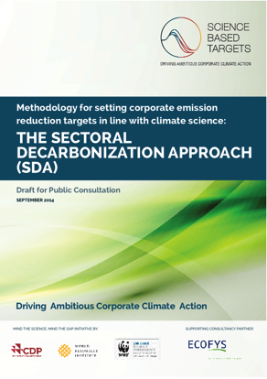


Mind the Science, Mind the Gap - Overview
methodology
high level exec. summary
website
An initiative by

Slide 7
Science-based target setting overview
Business as usual scenario
emissions increased by 2.2% on average every year
reach 3.7 to 4.8ºC of global warming by the end of the century
2ºC scenario
In 2050, 41 to 72% lower emissions than in 2010
2ºC carbon budget for the period 2011-2050 is in the range of 530 – 1300 GtCO₂ (144 – 354 GtC)
An initiative by

Slide 8
Science-based target setting overview
1. Absolute targets
2. Value-added approach
3. Sectoral decarbonisation approach
10 – 18% per decade (compared to 2010) based on IPCC AR5
Generic decarbonisation pathway based on 2ºC carbon budget and expected economic growth
Sector-specific decarbonisation pathway based on 2ºC carbon budget, expected sector activity and mitigation potential
An initiative by

Slide 9
Sectoral Decarbonisation Approach – Overview
The Sectoral Decarbonisation Approach (SDA) is a freely available open-source methodology that allows companies to set emission reduction targets in line with a 2oC decarbonisation scenario. It is based on the 2oC scenario (2DS) developed by the International Energy Agency (IEA) as part of its publication, Energy Technology Perspectives 2014 (IEA, 2014).
^{This methodology provides} a sector-based approach for companies to set GHG reduction targets necessary to meet a global 2°C temperature rise.
An initiative by

Slide 10
Sectoral Decarbonisation Approach – Overview
Highlights:
2ºC as temperature threshold for the methodology
450 ppm as emissions threshold - from RCP 2.6
1055 GTCO₂e as cumulative budget (2010-2050) – From IEA ETP 2014
Sector-specific budget & activity projections are obtained from 2DS modelling (peak & decline)
An initiative by

Slide 11
Sectoral Decarbonisation Approach – Assumptions
The carbon intensity of each company in a homogeneous sector will converge with the sectoral carbon intensity in 2050.
The SDA methodology intrinsically accounts for regional differences regarding level of activity and carbon intensity but not explicitly in relation to historical responsibility
Economic growth is decoupled from demand for energy and materials.
Added value of individual heterogeneous sectors is assumed to grow proportional to GDP growth.
Added value is defined as gross profit, which equals revenue minus cost of sold goods and services.
Emissions from heat, steam, and cooling are negligible compared with those of electricity; this also holds for the longer term.
Road vehicles are assumed to have a lifetime of 15 years; the carbon efficiency of new vehicles is calculated based on this assumption.
An initiative by

Slide 12
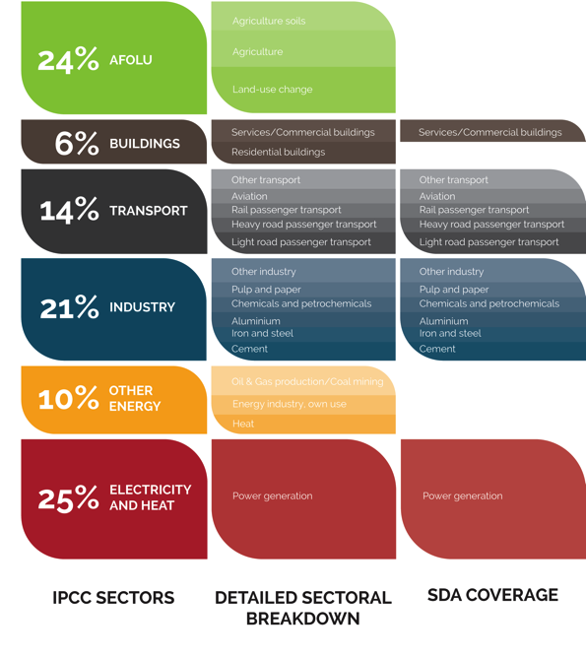
Sectoral Decarbonisation Approach – Coverage
About 60% of the global GHG emissions are covered by the SDA methodology.
Fossil fuel extraction and production not covered
Emissions from the residential sector (buildings) not covered
LULUCF emissions not covered (in version 1)
An initiative by

Slide 13
Sectoral Decarbonisation Approach – 2DS Decarbonisation Pathway
1055 GTCO₂e
SDA coverage
An initiative by

Slide 14
Sectoral Decarbonisation Approach – Sectoral Breakdown
An initiative by

Slide 15
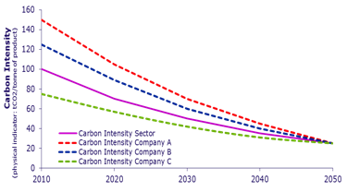
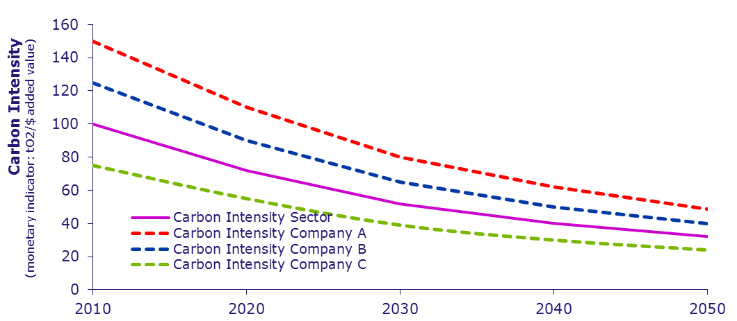
Sectoral Decarbonisation Approach – Compression & Convergence
Homogenous
The methodology assumes that the carbon intensity for the companies in all homogeneous sectors tend to converge in 2050. The rate of convergence depends on the differential between the carbon intensity of the company and the 2ºC carbon intensity of the sector. This differential declines linearly over time until 2050, when the carbon intensity of all companies is the same as the 2ºC carbon intensity for the sector.
Heterogenous
For more heterogeneous sectors the methodology uses value-added as an indicator of activity in the sector. ‘Gross profit’ is used as a proxy for value-added. In the absence of more sector-specific decarbonisation pathways, a reasonable alternative is to depict how the carbon-intensities of different companies would compress in order to be within a broad 2ºC carbon budget.
An initiative by

Slide 16
Sectoral Decarbonisation Approach – Scope 2 Target
Consumption of electricity represents the vast majority of Scope 2 emissions and the lack of 2ºC decarbonisation models for the heat and steam sectors, the indirect GHG emissions from consumption of purchased electricity is used as a proxy for Scope 2 emissions
Taking the total electricity consumption at the sector level, the 2ºC budget for the generation of this electricity (i.e. using the 2ºC carbon intensity indicator for the power sector), and the total sectoral activity, it is possible to estimate the Scope 2 carbon intensity for a sector.
Scope 2 emissions (and carbon intensity) for a company can be derived using the principle of compression (heterogenous sector) or convergence (homogenous sectors)
An initiative by

Slide 17
Sectoral Decarbonisation Approach – Scope 2 Target
Consumption of electricity represents the vast majority of Scope 2 emissions and the lack of 2ºC decarbonisation models for the heat and steam sectors, the indirect GHG emissions from consumption of purchased electricity is used as a proxy for Scope 2 emissions
Taking the total electricity consumption at the sector level, the 2ºC budget for the generation of this electricity (i.e. using the 2ºC carbon intensity indicator for the power sector), and the total sectoral activity, it is possible to estimate the Scope 2 carbon intensity for a sector.
Scope 2 emissions (and carbon intensity) for a company can be derived using the principle of compression (heterogenous sector) or convergence (homogenous sectors)
An initiative by

Slide 18
Sectoral Decarbonisation Approach – Scope 2 Target
Consumption of electricity represents the vast majority of Scope 2 emissions and the lack of 2ºC decarbonisation models for the heat and steam sectors, the indirect GHG emissions from consumption of purchased electricity is used as a proxy for Scope 2 emissions
Taking the total electricity consumption at the sector level, the 2ºC budget for the generation of this electricity (i.e. using the 2ºC carbon intensity indicator for the power sector), and the total sectoral activity, it is possible to estimate the Scope 2 carbon intensity for a sector.
Scope 2 emissions (and carbon intensity) for a company can be derived using the principle of compression (heterogenous sector) or convergence (homogenous sectors)
An initiative by

Slide 19
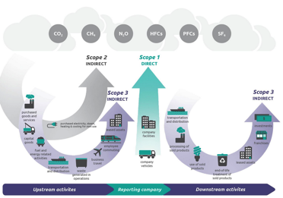
Sectoral Decarbonisation Approach – Scope 3 Target
Scope 3 category | Direction to set targets in line with a 2°C pathway
Category 1: Purchased goods and services | A target can be set based on the 2 °C pathway of the applicable supplier sector (e.g. the chemical sector for companies purchasing chemical compounds).
Category 6: Business travel | A target can be set based on the 2°C pathway of the light passenger transport and aviation sector.
Category 8: Upstream leased assets | A target can be set based on the 2°C pathway of the service buildings sector.
An initiative by

Slide 20
Sectoral Decarbonisation Approach – Step by Step
An initiative by

Slide 21
Sectoral Decarbonisation Approach – Areas for further development
• Structural parameters within sectors to more accurately account for deviations from a sector’s average structure
• Additional scope 3 emissions categories
• Additional sectors that have sector-specific science-based 2ºC decarbonisation pathways
^{This methodology provides} a sector-based approach for companies to set GHG reduction targets necessary to meet a global 2°C temperature rise.
An initiative by

Slide 22

Sectoral Decarbonisation Approach – Public Consultation
October 23rd
www.sciencebasedtargets.org
An initiative by

Slide 23
Sectoral Decarbonisation Approach – Engagement Opportunities
Comment
Test the methodology
Challenge its assumptions
Suggest improvements
Share
Share the methodology
Invite other businesses to use it
Let peers know about the public consultation
Inspire
Opportunities to showcase companies already setting science-based targets (e.g. website, webinars, video, side-events, etc.)
Support
We are looking for funds to support this work through the different activities that have been planned (guidance, monitoring, benchmarking, capacity building, etc.)
An initiative by

Slide 24
discussion
METHODOLOGY OVERVIEW & CONSULTATION
An initiative by

