Slide 1

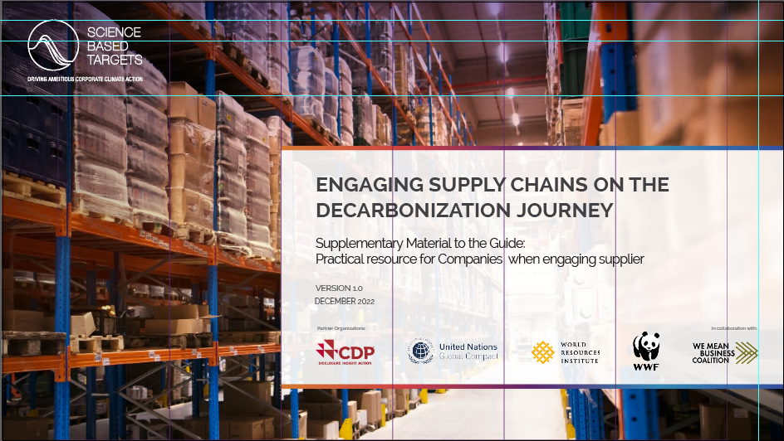

ENGAGING SUPPLY CHAINS ON
THE DECARBONIZATION JOURNEY
A SUPPLEMENTARY RESOURCE TO THE SBTi SUPPLIER ENGAGEMENT GUIDANCE
INTRODUCTION TO THE SCIENCE BASED TARGETS INITIATIVE
May 2023
DISCLAIMER: This presentation together with its speaker script was developed by the Science Based Targets initiative, for companies engaging their suppliers on the topic of science-based target setting. This resource is publicly available on the SBTi website and should not be altered.

Slide 2

ABOUT THIS PRESENTATION AND SPEAKER SCRIPT
NOTES FOR COMPANIES WITH SUPPLIER ENGAGEMENT TARGETS
This slide deck and the speaker script are intended for companies with science-based targets - including supplier engagement targets - to use when educating and engaging their suppliers on science-based target setting.
These are complementary resources for companies to use as part of their engagement programs.
The SBTi encourages companies to also familiarize with other key SBTi resources to ensure you know the basics of what science-based targets are, the criteria, and how to set them.

Slide 3
AGENDA
Introduction to the Science Based Targets initiative
About the Science Based Targets initiative (SBTi)
SBTi Progress to date
Who is eligible to join the SBTi?
What are the benefits of joining the SBTi?
How can companies set science-based targets?
Additional sections
VI. Introduction to the GHG Protocol
VII. Scopes 1, 2 and 3 accounting

Slide 4
I. ABOUT THE SCIENCE BASED TARGETS INITIATIVE

Slide 5



ABOUT THE SCIENCE BASED TARGETS INITIATIVE
AN UNPRECEDENTED COLLABORATION
The Science Based Targets initiative (SBTi) is a global body enabling business and financial institutions to set ambitious emissions reductions targets in line with the latest climate science.
FUNDING PARTNERS
IN COLLABORATION WITH

Slide 6



ABOUT THE SCIENCE BASED TARGETS INITIATIVE
WHAT DOES IT DO?
Defines and promotes best practice in line with climate science.
Provides technical assistance and expert resources.
Provides companies with independent assessment and validation of targets.
Works with leading companies to scale up the adoption of science-based targets (SBTs) and halve emissions by 2030 in line with a 1.5°C future.

Slide 7




THE NEED TO MAINSTREAM SCIENCE-BASED
TARGETS
 | 1.5°C | 2.0°C | 2°C impacts
Global population exposed to severe heat at least once every 5 years | 14% | 37% | 2.6x worse
Number of ice-free arctic summers | At least 1 every 100 years | At least 1 every 10 years | 10x worse
Further decline in coral reefs | 70-90% | 99% | Up to 29% worse
Decline in marine fisheries | 1.5M tonnes | 3M tonnes | 2x worse
Atmospheric concentrations of CO2 continue to grow. In 2019, GHG emissions reached a new record high of 59.1 gigatons of CO2 equivalent.
Countries committing to net-zero emissions has been the most significant and encouraging climate policy development of 2020, yet near-term emissions reductions are critical to achieving net-zero by 2050 at the global level.
Source: Levin, K. (2018, Oct 7). 8 Things You Need to Know About the IPCC 1.5˚C Report. Retrieved from https://www.wri.org/blog/2018/10/8-things-you-need-know-about-ipcc-15-c-report

Slide 8
II. SBTi PROGRESS TO DATE

Slide 9



INTRODUCTION TO THE SBTi
2025 GOALS: PROGRESS TO DATE
Market capitalization
Corporate emissions
Commitments
& targets
2025 GOALS
$20T
5.0GT
10.0K
global
economy
corporate emissions
companies worldwide
COMMITTED
$38B
5.0GT
4.9K
VALIDATED
-
1.5GT*
2.6K
* Only scope 1 and 2. Only 80% of validated targets.
Data from 2021.

Slide 10









INTRODUCTION TO THE SBTi
SBTi COMPANIES NOW REPRESENT:
Since its foundation, the SBTi has validated science-based targets of 5,000+ organizations worldwide - including sector leaders, such as:
4/10 largest cement companies worldwide.
9/10 largest pharmaceutical
companies in the world.
35% global market capitalization
4/20 top banks in Europe.
8/10 the world’s Largest food companies.
2/10 consumer durables companies in the world
One of the largest integrated energy companies in the world.
53M tonnes CO₂
total committed annual emissions reductions
See SBTi’s target dashboard for more information on companies taking action.
27% high-impact companies
Data from 2021.

Slide 11
INTRODUCTION TO THE SBTi
2022: THE SBTi’s MOST SUCCESSFUL YEAR YET
2000
200
net-zero validated companies
24%
SBTi-companies are now from Asia
1000
3GT
covered by commitments and validated targets
2865+
companies and FIs with validated targets
Targets validated in 2022
Data from 2022.

Slide 12
III. WHO IS ELIGIBLE TO JOIN THE SBTi?

Slide 13


WHO IS ELIGIBLE TO JOIN THE SBTi?
Companies at the parent company level are recommended, but subsidiaries are also welcome to join.
Financial institutions, including banks, investors, insurance companies, pension funds and others.
The SBTi does not assess targets for cities, local governments, public sector institutions, educational institutions or non-profit organizations. Cities can register their interest in setting targets through the Science Based Targets Network.
Commitments and validations for fossil fuel companies have been paused while sector guidance is developed.
Near- and long-term target validations and target updates for automakers are paused until 1.5°C scope 3 targets for use-phase emissions from new road vehicles are developed and approved. Automakers are still able to commit to set targets.

Slide 14
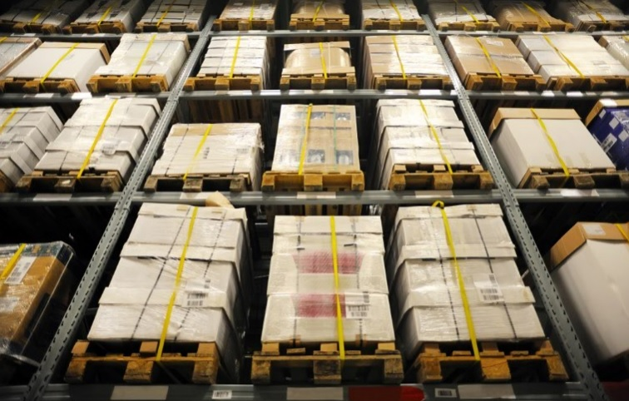
WHO IS ELIGIBLE TO JOIN THE SBTi?
SMALL AND MEDIUM-SIZED ENTERPRISES (SMEs)
An SME is defined for SBTi purposes as an independent, non-subsidiary company with fewer than 500 employees.
The SBTi introduced a streamlined route to approve science-based targets for SMEs. The short target-setting letter simplifies the process, giving SMEs the choice of targets (near-term and/or long-term targets).
All SMEs must use this exclusive route to join the SBTi.
Note that this does not include Financial Institutions and Oil & Gas companies.

Slide 15
IV. WHAT ARE THE BENEFITS OF JOINING THE SBTi?

Slide 16


BENEFITS OF SETTING SCIENCE-BASED TARGETS
THE CASE FOR THE PLANET, PEOPLE & BUSINESSES
Reduces the pollution blanket around Earth.
Supports the phase out of carbon pollution from fossil fuels.
Contributes to protecting human health.
Prevents economic damage.
Protects all types of animal and plant life.
Good for the planet and the people
Future-proofs growth.
Saves money.
Provides resilience against regulation.
Boosts investor confidence.
Spurs innovation and competitiveness.
Good for your business

Slide 17
BENEFITS OF SETTING SCIENCE-BASED TARGETS
PREPARE FOR SHIFTS IN PUBLIC POLICY AND BUILDS BUSINESS RESILIENCE
Influence and prepare for shifts in public policy
Build business resilience and increase competitiveness
Reduce a company’s exposure to more stringent emissions and energy regulations.
Adapt to changing policies and send a stronger signal to policymakers, to better influence policy decisions.
Stand out from competitors as climate change regulations become more stringent.
Better positioned to respond to future regulatory adjustments as governments ramp up their climate action.
Challenge business to re-align with the net-zero economy, capitalising on a range of opportunities beyond cost-savings and avoiding the risk of stranded assets.
Reducing emissions in operations and value chain:
  Increase resilience and competitiveness.
  Save money on energy costs from manufacturing and logistics operations (and hedge against fossil fuel prices).

Slide 18
BENEFITS OF SETTING SCIENCE-BASED TARGETS
DRIVE INNOVATION AND BUILD EXTERNAL CREDIBILITY
Drive innovation and transform business practices
Build credibility and reputation with employees, customers, investors and other stakeholders
As SBTs include a long-term vision, companies can think beyond the near-term, common solutions for GHG emissions reductions.
New technologies and financing options can be developed in a corporate environment that prioritizes preparing for a net-zero economy.
Redefine a company’s bottom line by creating new products, new ways to source materials, to interact with customers, and to grow markets.
SBTs have higher credibility with stakeholders. Companies often lower-risk options for long-term investment.
More investors are turning towards businesses with clear commitments to climate action.
More employees take company's social and environmental commitments into consideration when making employment decisions.
Consumers are changing their habits, consuming products that are socially and environmentally responsible.

Slide 19




BENEFITS OF SETTING SCIENCE-BASED TARGETS
SBTi BUSINESS CASE: BECOMING A STANDARD BEYOND THE PRIVATE SECTOR
The UK Government call for potential sponsors of COP26, allowing only companies with ‘strong climate credentials’ evidenced by science-based targets. Additionally, suppliers of the UK government are already required to have net-zero targets for 2050 or earlier.
The financial sector is increasingly using science-based targets as a benchmark. In 2020, a group of 137 global financial institutions, holding nearly US$20 trillion in assets, called on companies to set 1.5°C-aligned science-based targets and achieve net-zero emissions by 2050 at the latest.
The White House announced its intention to require all suppliers of the federal government to set science-based targets. The federal government is the largest purchaser in the worlds.
Norway became the first country in the world to announce a plan for all state-owned companies to set science-based targets.

Slide 20
V. HOW CAN COMPANIES SET SCIENCE-BASED TARGETS?

Slide 21

HOW TO SET A TARGET
TWO DIFFERENT ROUTES
LARGE COMPANIES & FINANCIAL INSTITUTIONS
STANDARD ROUTE
SMALL AND MEDIUM-SIZED ENTERPRISES
SME ROUTE
For the purposes of target validation by the SBTi, an SME is defined as a non-subsidiary independent company with fewer than 500 employees.

Slide 22
STANDARD ROUTE:
LARGE COMPANIES & FINANCIAL INSTITUTIONS

Slide 23





HOW TO SET A TARGET
STANDARD ROUTE: LARGE COMPANIES & FINANCIAL INSTITUTIONS
DAY 1
24 MONTHS
AFTER APPROVAL
COMMIT
DEVELOP
SUBMIT
COMMUNICATE
DISCLOSE
STEP 1: Company submits a letter establishing its intent to set a science-based target
STEP 2: Company works on an emissions reduction target in line with the SBTi criteria
STEP 3: Company presents the target to the SBTi for official validation
STEP 4: Company announces the target and inform stakeholders
STEP 5: Company report its wide emissions and progress against targets on an annual basis

Slide 24
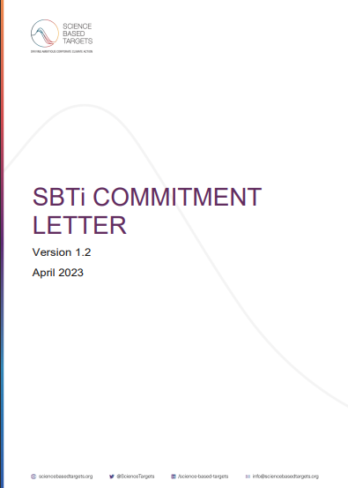
HOW TO SET A TARGET
STEP 1: COMMIT | COMMITMENT LETTER
LARGE COMPANIES & FINANCIAL INSTITUTIONS

Slide 25

HOW TO SET A TARGET
STEP 1: COMMIT
Near-term science-based targets are required. This means that when a company signs the commitment letter, it is committing to set a near-term target.
Net-zero science-based targets are an additional commitment, this means that in addition to setting a near-term target, companies can choose to also set a net-zero target.
To commit to setting a net-zero science-based target, companies must check the "set net-zero targets" option in the commitment letter.
Companies that commit to setting net-zero science-based targets automatically join the Race to Zero* campaign.
“We urge businesses and investors to join the Race to Zero, align their portfolios with the goals of the Paris Agreement and set science-based net-zero targets of 2050 at the latest.”
G7 Climate and Environment Ministers, May 2021.
Non-state actors committed to net-zero through partner initiatives such as SBTi
* Companies that are eligible to join the Race to Zero must follow the SBTi’s current fossil fuel policy. If companies have questions, please reach out to Race to Zero at racetozero@unfccc.int.

Slide 26
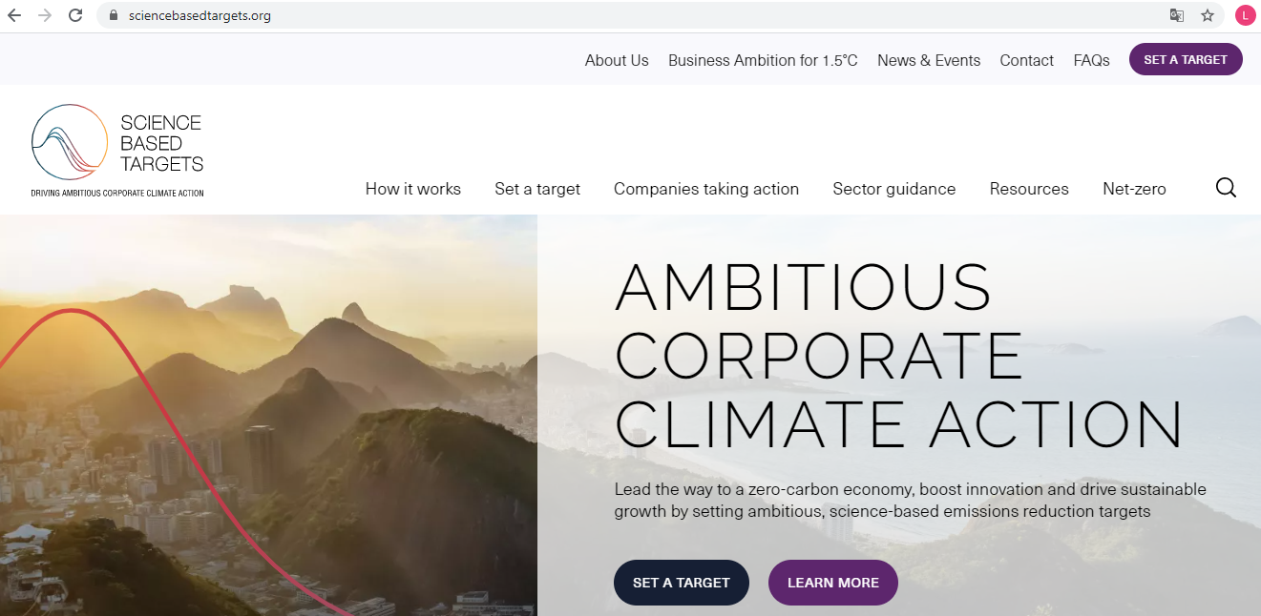
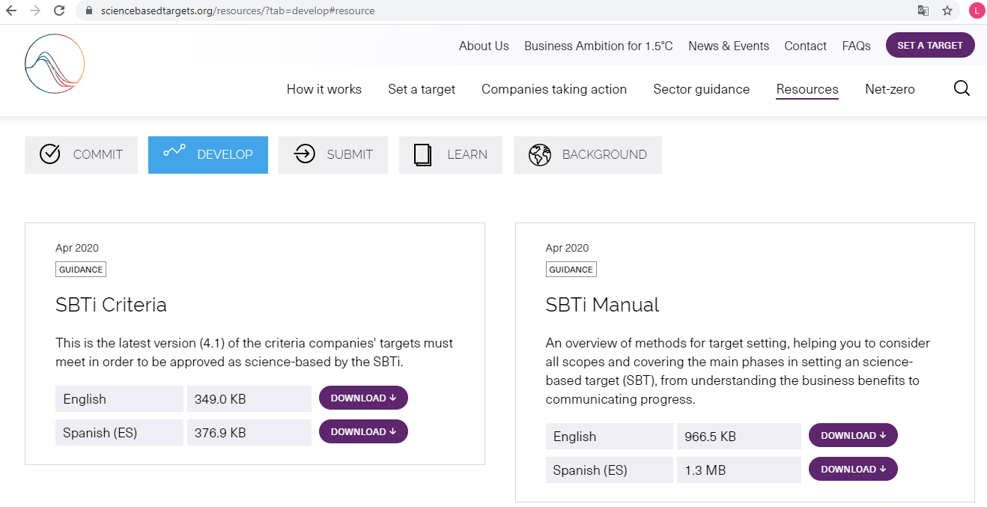
HOW TO SET A TARGET
STEP 2: DEVELOP THE TARGET | KEY RESOURCES WHERE TO FIND
Access the initiative's website: www.sciencebasedtargets.org.
On the main menu, click on "Resources".
3. Scroll down a little bit.
4. The resources are presented according to the stage in which they will be used: commit, develop, submit, learn and background.
5. Click on the corresponding menu and access the resources you want.

Slide 27
HOW TO SET A TARGET
STEP 2: DEVELOP THE TARGET | KEY RESOURCES OVERVIEW
Tools
Excel tools for modeling targets.
5
Target Validation Protocol
Presents how the team checks and classifies targets against the SBTi Criteria.
4
SBTi Criteria and Recommendations
Presents the criteria and recommendations for the development of SBT targets. Companies are validated against these criteria.
3
SBTi Corporate Manual
Presents the steps to join the initiative, and guidance for companies to develop their targets for scopes 1, 2 and 3.
2
1
Foundations of Science-Based Targets
Explains how the SBTi has leveraged newly available science to align its methods with 1.5°C and well-below 2°C pathways.
Understand how to set science-based targets through
SBTi How-To Guide

Slide 28
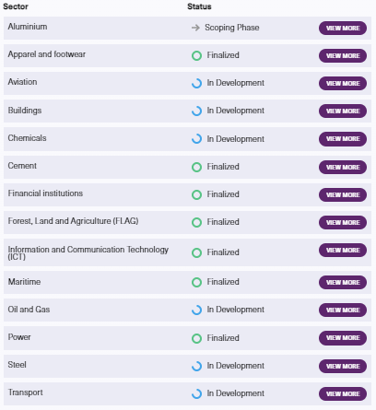
HOW TO SET A TARGET
STEP 2: DEVELOP THE TARGET | OVERVIEW OF METHODS FOR VARIOUS SECTORS
The SBTi provides companies with a range of resources to support them through the target-setting process.
For some sectors / industries, separate sector-specific methodologies, frameworks and requirements have been developed.
If your sector is not listed here (or if your sector-specific project is not finalized), you should use our core methodologies and resources to set your targets.
Access the SBTi Sector Guidance webpage to find detailed info about each sector: https://sciencebasedtargets.org/sectors.

Slide 29
HOW TO SET A TARGET
FOUR CONSIDERATIONS FOR SETTING NEAR-AND LONG-TERM SBTs
      Boundary
      Ambition
      Timeframe
      Methods
How much coverage or your emissions inventory is required?
What is the ambition level in terms of limiting temperature rise?
What is the maximum timeframe to meet your targets?
What are the eligible methods to set your targets?
1. Absolute contraction
Near-term science-based target
Scope 1+2: 95%
Scope 1+2: 1.5°C
5-10 years from date of submission
2. Physical intensity convergence
Scope 3: If >40% of total emissions, 67% coverage
Scope 3: Well-below 2°C
3. Renewable electricity
4. Supplier or customer engagement*
5. Economic intensity*
6. Physical intensity contraction*
Scope 1+2: 95%
Scope 3: 90%
Scope 1+2+3: 1.5°C
2050 latest
1. Absolute contraction
2. Physical intensity convergence
Long-term science-based target
3. Renewable electricity
4. Economic intensity*
5. Physical intensity contraction*
* Scope 3 only

Slide 30
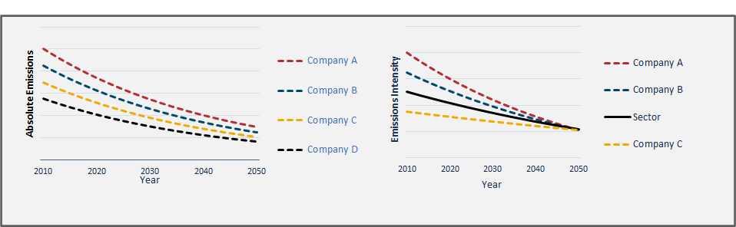
HOW TO SET A TARGET
STEP 2: DEVELOP THE TARGET | METHODS FOR SCOPE 1 & SCOPE 2
Absolute-based approach
All sectors
Equal % of reduction
IPCC carbon budgets scenarios
Sector-based approach
Homogeneous sectors
Different % of reduction
Sectoral carbon budgets (e.g. IEA*)
Sectoral Decarbonization Approach (SDA)**
Contraction
Convergence
* International Energy Agency
** Developed by the SBTi

Slide 31
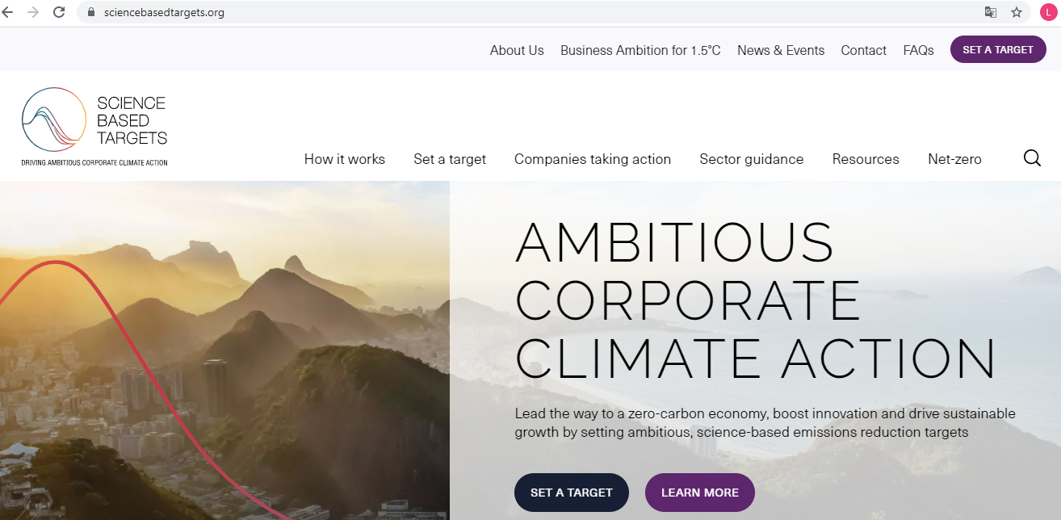
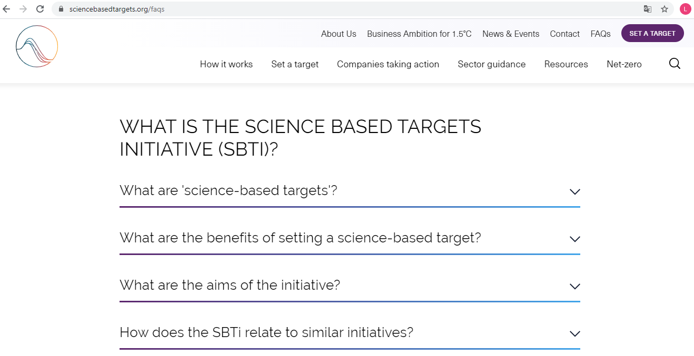

HOW TO SET A TARGET
STEP 2: DEVELOP THE TARGET | FAQ
SBTi YouTube Channel

Slide 32
HOW TO SET A TARGET
STEP 3: SUBMIT | TARGET VALIDATION PROCESS
DATA SUBMISSION
BOOKING SYSTEM
VALIDATION
PROCESS
VALIDATION DECISION
The company submits its targets using the Target Submission Form.
The company reserves a date for their target validation service to begin.
The target validation team performs target assessment.
Near-term: 30 business days.
Long-term: 60 business days.
The company receives Target Assessment Report.

Slide 33
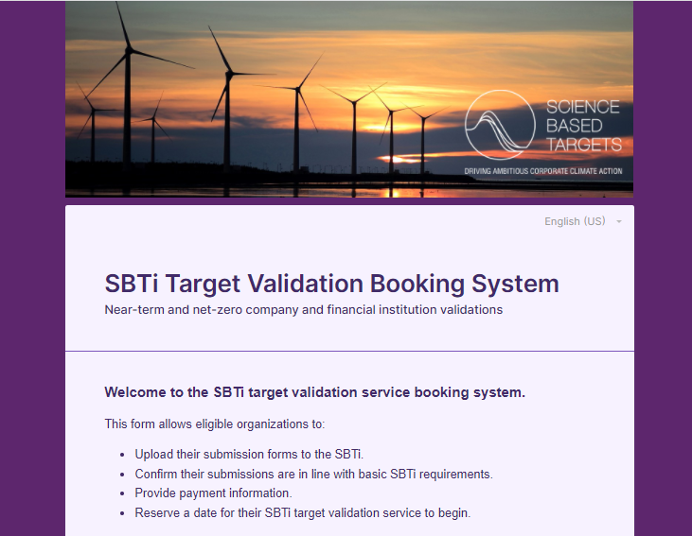
HOW TO SET A TARGET
STEP 3: SUBMIT | TARGET VALIDATION BOOKING SYSTEM
Companies reserve a slot to have targets validated through the validation booking system.
The booking system allows companies to:
Upload their complete submission forms to the SBTi.
Screen questions to confirm the submission is in line with basic SBTi requirements.
Reserve a date for their SBTi target validation service to begin.
Provide payment information.

Slide 34
HOW TO SET A TARGET
STEP 3: SUBMIT | TARGET VALIDATION SERVICE FOR NET-ZERO
60 days for validation, but may be completed sooner
Net Zero Submission (Long-Term Targets)*
Can include multiple phases of review if there are outstanding questions about pre-existing near-term targets
* Only an option if your company already has SBTi validated near-term targets aligned with the NZ standard
Types of Net-Zero Submissions
60 days for validation
Net Zero Package Submission (Near and Long-Term Targets)
Several phases of review necessary; near-term targets are evaluated first to ensure they are in line with NZ criteria
Near-term update +
NZ submission
Near-term submission + NZ submission

Slide 35
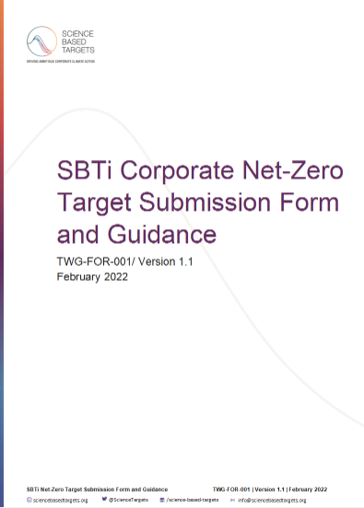
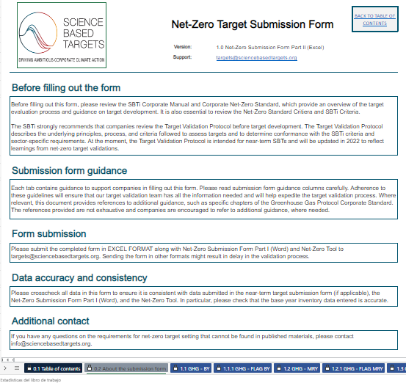
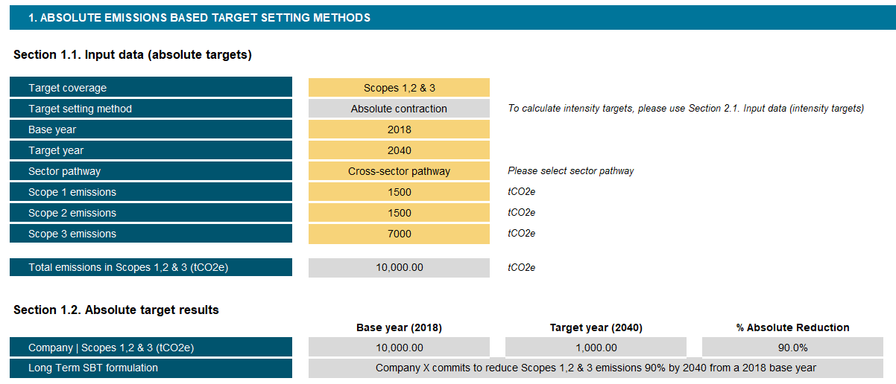
HOW TO SET A TARGET
STEP 3: SUBMIT | DOCUMENTS FOR NET-ZERO TARGET VALIDATION
Net-Zero Target Submission Form Part I (Word)
Net-Zero Target Submission Form Part II (Excel)
Net-Zero Tool
Contains questions about:
Validation type
Business activities
Bioenergy emissions
Exclusions
Near-term and long-term target
Neutralization/Beyond Value Chain Mitigation
Companies enter full GHG inventory for base year and most recent year (including optional, bioenergy, and FLAG emissions).
Auto-calculates boundary coverage of targets.
Data needed to calculate net-zero target with the SBTi Tool:
Scope 1, 2 & 3 emission inventory (broken down by activity/sector if modelling multiple targets).
Base year and base year output.
Companies pursuing net-zero package submissions must also submit a near-term target update/submission form..

Slide 36
HOW TO SET A TARGET
STEP 3: SUBMIT | TARGET VALIDATION PROCESS DETAILED
INITIAL SCREENING
LEAD REVIEWER DESK REVIEW
APPOINTED APPROVER REVIEW
TARGET VALIDATION TEAM DISCUSS
COMMUNICATING DECISION AND FEEDBACK
To determine if all necessary information is provided and/or to assess if the target meets the basic criteria
Lead reviewer performs the desk review to access the targets against the SBTi criteria and sends queries if needed
Appointed approver reviews the assessment done by the lead reviewer
Target validation team discusses the target and the desk review completed by the lead reviewer in a weekly meeting
The company receives a target validation report and a decision letter within 30 working days for near-term targets and 60 working days for long-term targets (with a 2 day turnaround for queries)
1
2
3
4
5

Slide 37


HOW TO SET A TARGET
STEP 4: COMMUNICATION GUIDELINES
The SBTi communications guidelines:
Once approved, companies must communicate their targets.
The SBTi publishes approved targets on its website and on partner’s websites (We Mean Business and CDP).
SBTi communication guidelines:
  Help companies accurately communicate at all stages of their SBTi process.
  Should be carefully reviewed before booking a slot for validation.
  Are particularly useful for companies that have previously made net-zero or carbon neutral claims and are aligning with the SBTi Net-Zero Standard.
False Net-Zero Claim | Accurate Net-Zero Claim
Our company has already achieved net-zero emissions because we offset our entire emissions footprint. | In addition to our net-zero emissions targets that promote direct reductions, our company has invested in beyond value chain mitigation.
Our company will be net-zero as soon as we reduce emissions 90% across scopes 1 and 2. | Our company will reach net-zero once we’ve directly reduced emissions 90% or more across scope 1, 2, and 3, and permanently neutralized any residual emissions.
Our company has SBTi approved near-term targets for 2030 that are 1.5˚C aligned and therefore we will be net-zero by 2030. | Our company’s targets to halve emissions by 2030 put us on the path to being net-zero by 2050.

Slide 38

HOW TO SET A TARGET
STEP 5: DISCLOSE
Companies must publicly disclose their emissions inventory and progress against their targets on an annual basis.
Recommendations include annual reports, sustainability reports, the company’s website, and/or disclosure through CDP’s annual questionnaire.

Slide 39
SMALL AND MEDIUM- SIZED ENTERPRISES:
SME ROUTE

Slide 40
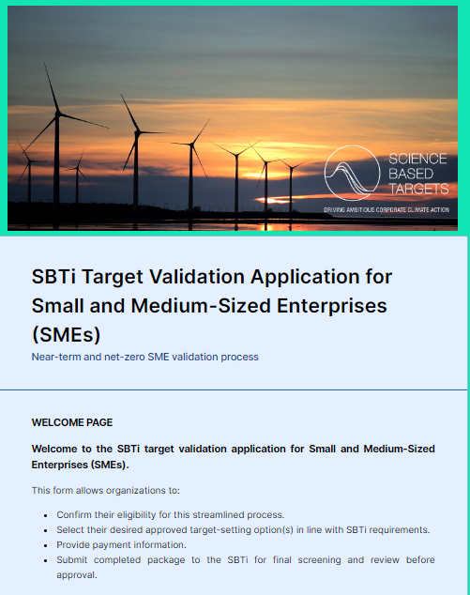
HOW TO SET A TARGET
SME ROUTE
The SBTi has developed an exclusive route for SMEs, and these must submit a target through this route.
It enables SMEs to bypass the regular target validation process and to immediately set a science-based target for scope 1 and 2.
Target options for SMEs:
  Near-term targets are absolute scope 1 and 2 GHG emissions reduction or maintenance targets that should be achieved by 2030, from a predefined base year.
  Net-zero targets include:
    Long-term science-based targets are absolute scope 1, 2 and 3 GHG emissions reduction targets that should be achieved by 2050 at the latest, from a predefined base year.
    A commitment to neutralize any unabated emissions when the long-term science-based target is achieved.
Target setting application for SMEs

Slide 41
HOW TO SET A TARGET
SME ROUTE
DAY 1
ONCE COMPANY RECEIVES FORMAL APPROVAL
AFTER APPROVAL
The company completes the SME Target Validation Booking System form, for the SBTi to review the information submitted
And, upon payment, the company’s target is published on the website
Company reports its GHG inventory and progress against target on an annual basis

Slide 42

THE TIME TO ACT IS NOW! LEAD THE WAY TO A GLOBAL NET-ZERO FUTURE
SCIENCE-BASED TARGETS PROVIDE A CLEARLY-DEFINED PATH TO REDUCE EMISSIONS IN LINE WITH THE PARIS AGREEMENT GOALS

Slide 43
ADDITIONAL SECTIONS

Slide 44
VI. INTRODUCTION TO THE GHG PROTOCOL

Slide 45
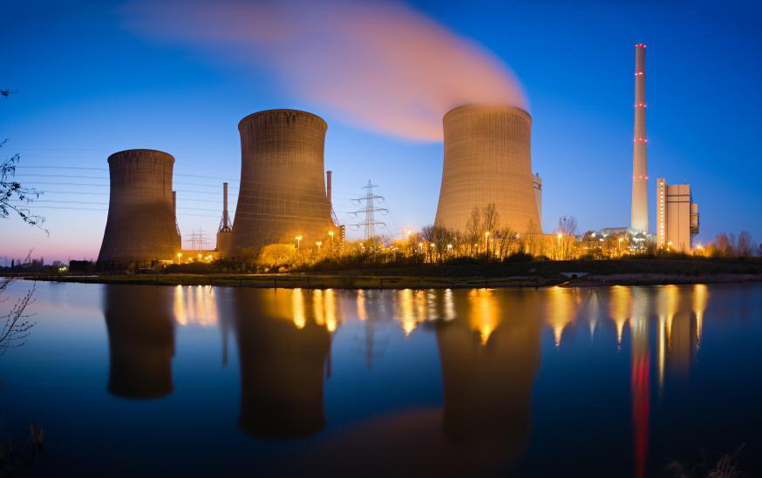
GHG PROTOCOL
UNDERSTANDING GHG ACCOUNTING
“The GHG Protocol establishes global standardized frameworks to measure and manage greenhouse gas (GHG) emissions from private and public sector operations, value chains and mitigation actions.”
It supplies the world's most widely used GHG accounting standards and provides an accounting platform for virtually every corporate GHG reporting program in the world Corporate Accounting and Reporting Standard.
Source: GHG Protocol

Slide 46

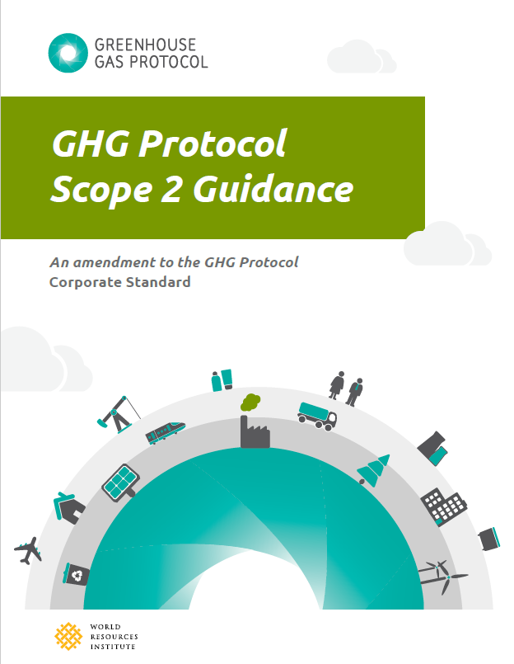
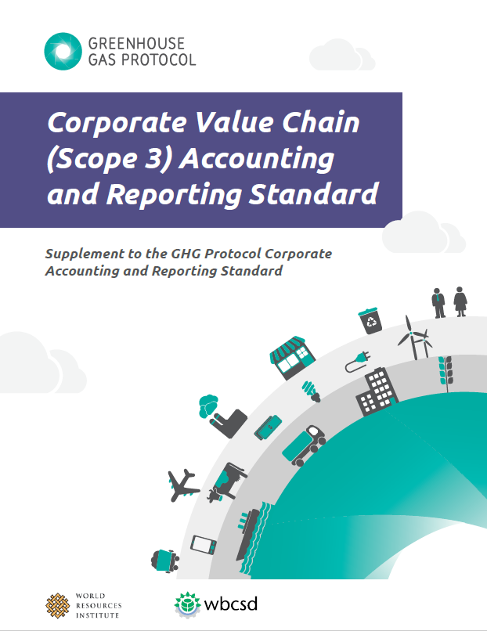
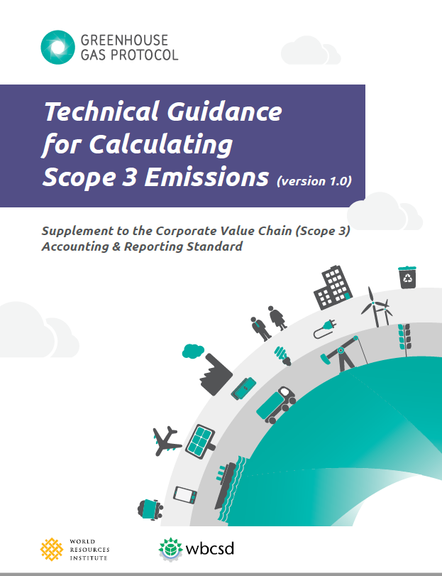
GHG PROTOCOL
STANDARDIZED FRAMEWORKS TO MEASURE GHG
In preparation to set a science-based target, companies need to complete an inventory of all
seven major greenhouse gases in accordance with the GHG Protocol standards.
Access the GHG Protocol webpage to download the accounting standards here.

Slide 47
VII. SCOPES 1, 2 AND 3 ACCOUNTING

Slide 48
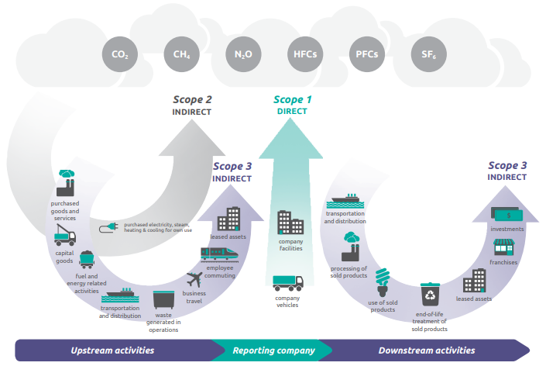
SCOPES 1, 2 AND 3 EMISSIONS ACCOUNTING
WHAT ARE SCOPE 1, SCOPE 2 & SCOPE 3 EMISSIONS?
Scope 1 – Direct emissions on site (e.g., on-site energy use).
Scope 2 – Emissions from purchased electricity, heat and steam.
Scope 3 – All other indirect emissions along the value chain.
Note: All companies must complete at least a scope 3 screening for all relevant categories. If scope 3 is over 40% of total emissions, an emissions inventory must be provided (estimations at minimum).
Source: GHG Protocol

Slide 49
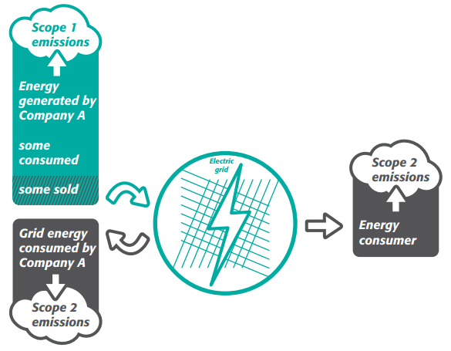
SCOPES 1, 2 AND 3 EMISSIONS ACCOUNTING
FOCUS ON SCOPE 1 & SCOPE 2 EMISSIONS
Scope 1 emissions:
  Biomass-related emissions to be included in the target boundary.
  CO₂ emissions from land use change are reported outside of the scopes
Scope 2 emissions:
  Two approaches to calculate scope 2 emissions:
    Location-based.
    Market-based.
Companies may set targets on the procurement of renewable electricity.
SBTs must cover at least 95% of company-wide scope 1 and 2 emissions.
Since July 15, 2022, targets must align with 1.5°C.
Source: GHG Protocol
*Purchased heat and steam - companies should model heat- and steam-related emissions as if they were part of their direct (i.e., scope 1) emissions. SDA methods do not take purchased heat and steam into account under scope 2 emissions.

Slide 50
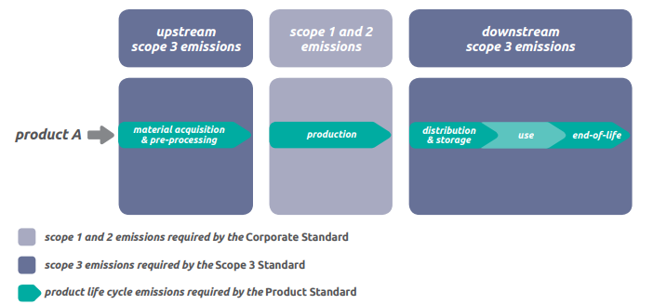
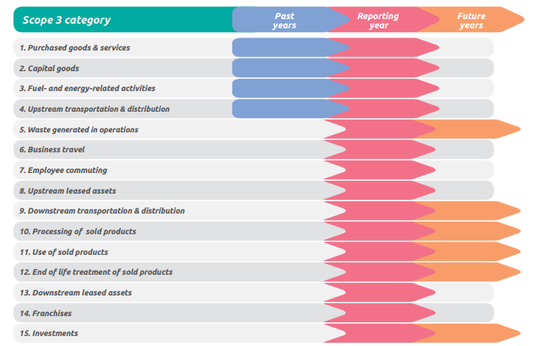
SCOPES 1, 2 AND 3 EMISSIONS
ACCOUNTING
FOCUS ON SCOPE 3 EMISSIONS
Scope 3 screening/inventory.
Scope 3 target required if total emissions ≥40%.
Scope 3 targets should cover at least 2/3 (i.e., 67%) of total scope 3 emissions.
Indirect use-phase emissions or other optional sources of scope 3 emissions do not count towards the 2/3 boundary.
For more details on scope 3 emissions: Corporate Value Chain (Scope 3) Accounting and Reporting Standard.
Source: GHG Protocol

Slide 51
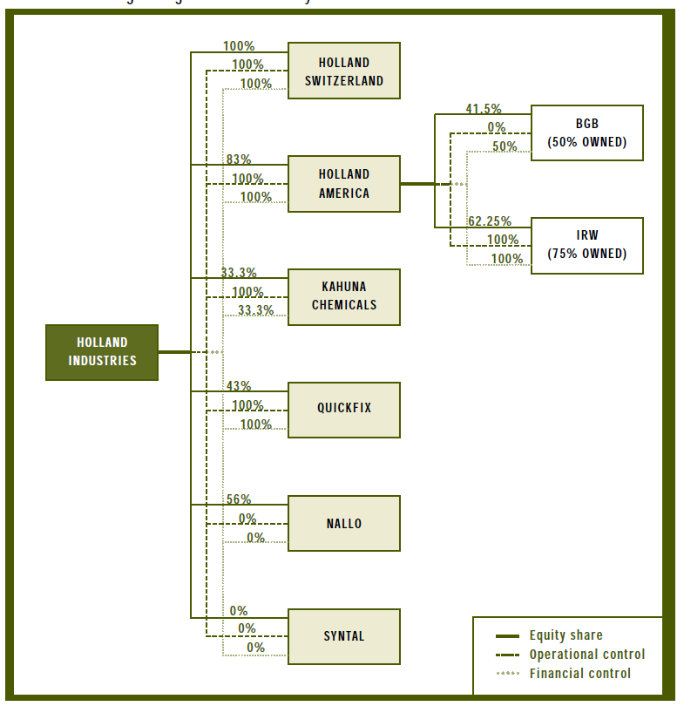
SCOPES 1, 2 AND 3 EMISSIONS ACCOUNTING
GHG INVENTORY CONSOLIDATION APPROACHES
Companies should set science-based targets in line with their selected consolidation approach.
1. Equity share approach
Company accounts for GHG emissions from operations according to its share of equity in the operation.
2. Control approach
Company accounts for 100% of the GHG emissions from operations over which it has control.
Financial Control.
Operational Control.
Source: GHG Protocol: A Corporate Accounting and Reporting Standard

Slide 52
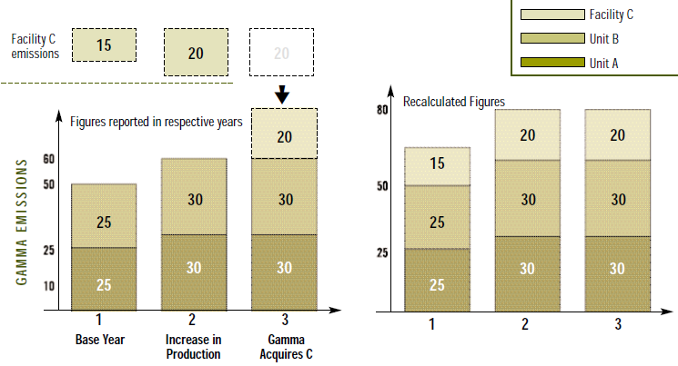
SCOPES 1, 2 AND 3 EMISSIONS ACCOUNTING
TRACKING EMISSIONS OVER TIME
Structural changes can trigger base year recalculations, as well as science-based targets recalculations. Check out the SBTi criteria on target recalculation.
Science-based targets should be reviewed every 5 years.
Choosing a base year
Verifiable emissions data are available and can be used as a basis for setting and tracking progress towards a GHG target.
Recalculating base year emissions
Develop base year emissions recalculation policy, and clearly articulate the basis and context for any recalculations.
May arise due to mergers, acquisitions, and divestments, outsourcing, insourcing, calculation method changes, cumulative significant errors etc.
Source: GHG Protocol: A Corporate Accounting and Reporting Standard

Slide 53

SCOPES 1, 2 AND 3 EMISSIONS ACCOUNTING
LEARN MORE ABOUT GHG ACCOUNTING STANDARDS
Visit the Greenhouse Gas Protocol webpage: www.ghgprotocol.org to learn more about the Protocol and greenhouse gas accounting standards.
You’ll find online learning solutions to get up-to-speed on the world's most widely used GHG accounting standards.

Slide 54

THANK YOU!
For general information and technical queries contact us at: info@sciencebasedtargets.org

